Slide 1
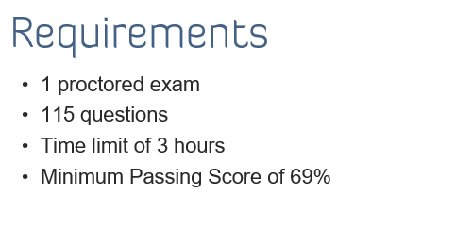
SANS GISCP EXAM SUMMARY
Each SANS exam has a different min pass score – ranges from 69-80%. Most exams are in the mid 70%.
GICSP Passing Score 69%
Over 85% is exceptional and SANS notices ☺

Slide 2
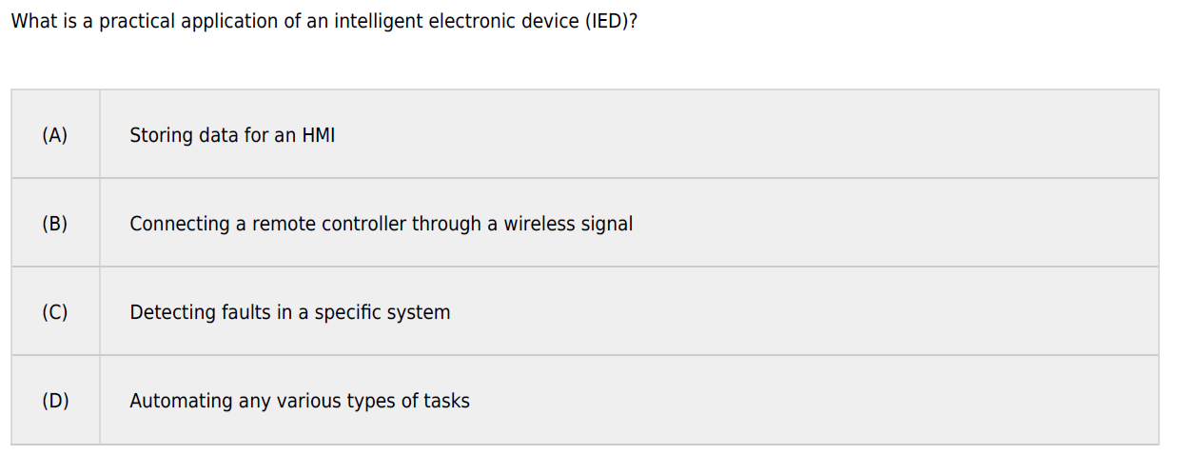
ANS: C

Slide 3
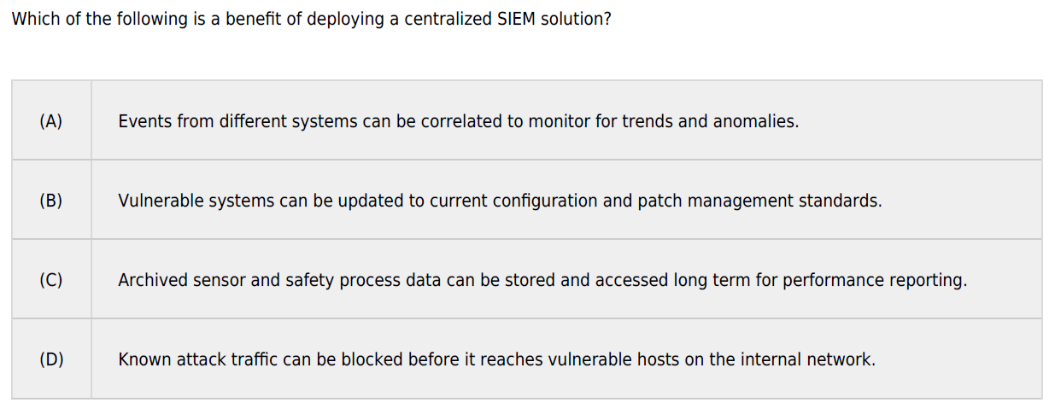
ANS: A

Slide 4
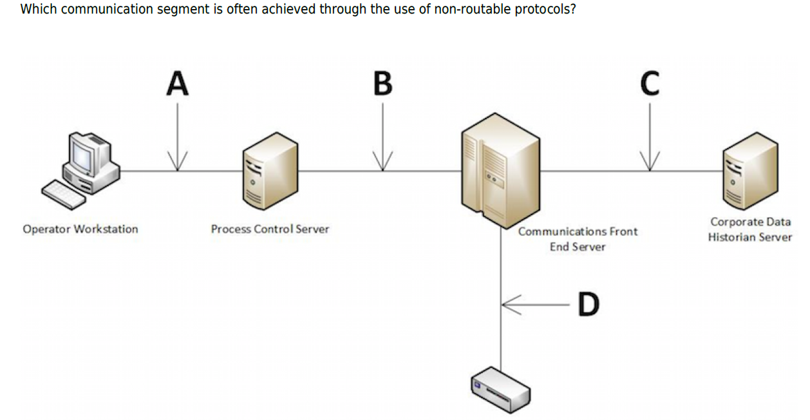
ANS: D

Slide 5
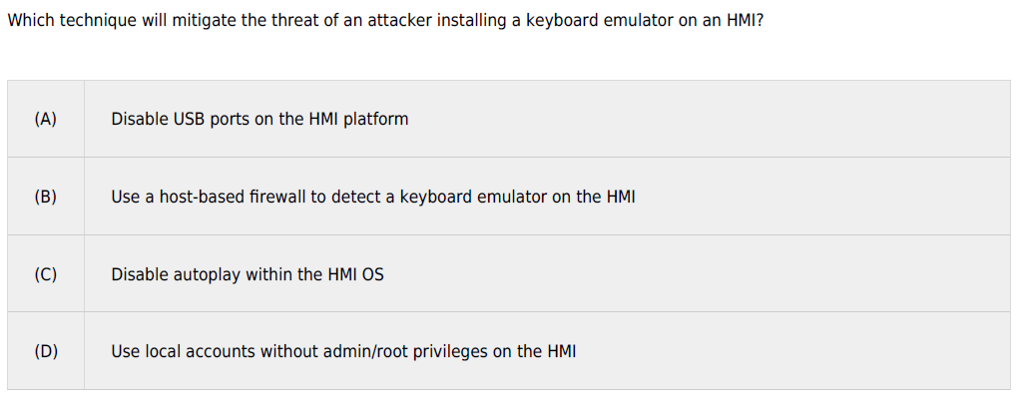
ANS: A

Slide 6
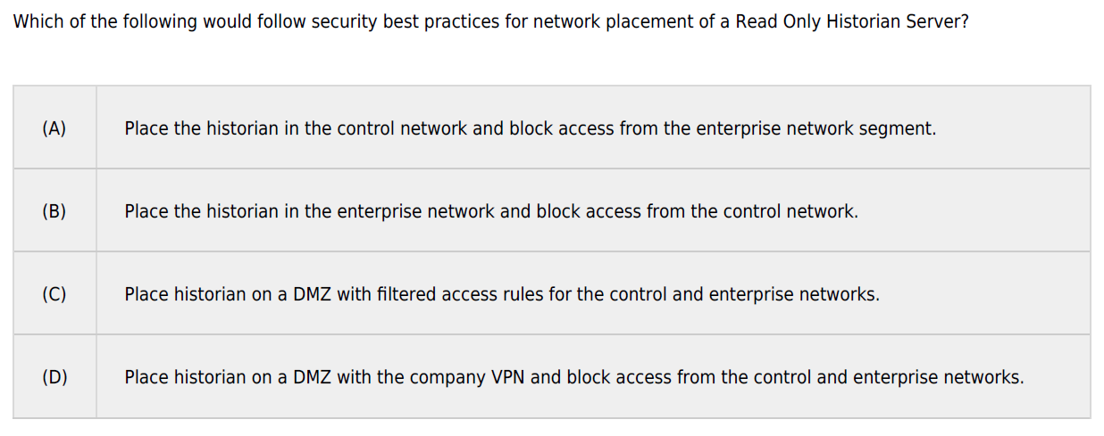
ANS: C

Slide 7
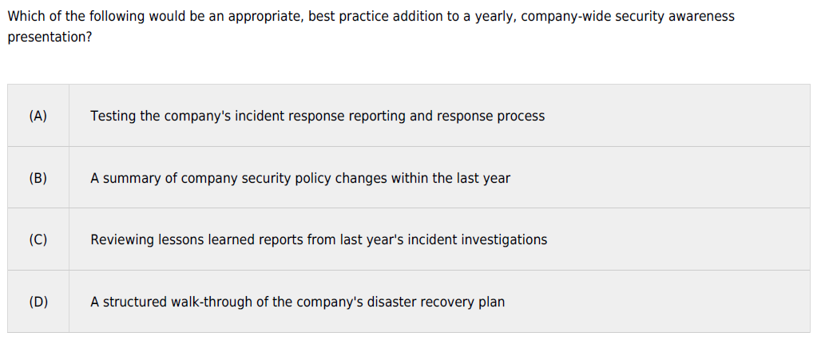
ANS: B

Slide 8
ANS: C
Which of the following removable media remediation actions requires vendor involvement?
a) requiring encrypted removable media
b) disabling optical media drives in system BIOS
c) eliminating a USB software dongle
d) implementing a removable media policy

Slide 9
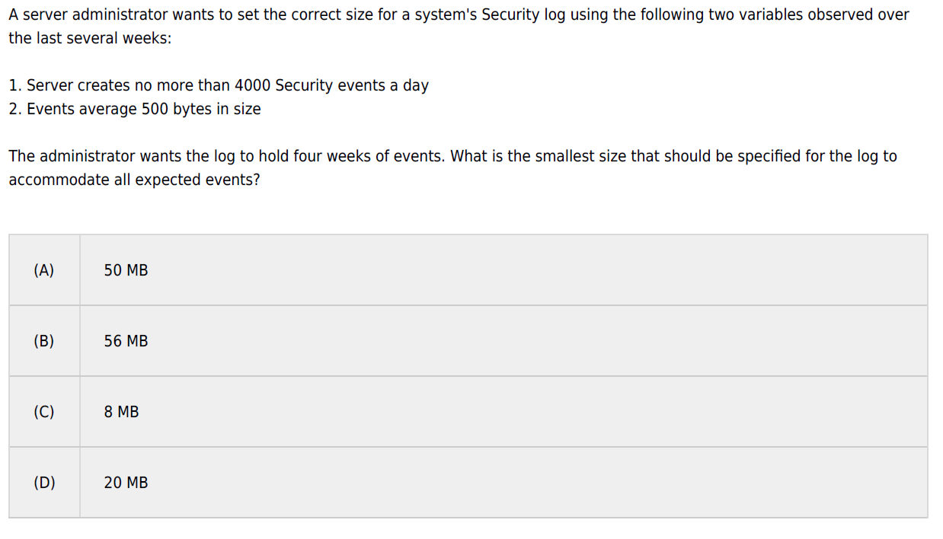
ANS: B

Slide 10
ANS: D
What risk does SecureDNP3 mitigate?
a) lack of logging
b) denial of service attacks
c) lack of encryption
d) lack of authentication

Slide 11
ANS: A
Which of the following actively simulates the most realistic external attack scenario?
a) Black box penetration test
b) White box penetration test
c) Vulnerability assessment
d) Threat assessment

Slide 12
ANS: B
You use syslog for device logging. What port do you need to ensure is open between your device and log server?
a) udp 23
b) udp 514
c) tcp 21
d) tcp 443

Slide 13
ANS: C
Which of the following tools can help you monitor what’s happening on a production network without the risk of adding additional network traffic?
a) nmap
b) hping
c) wireshark
d) nessus

Slide 14
ANS: C
Bubba is installing a new RTU’s for Tocpe Energy that have a web server running on them by default. Tocpe Energy will not be using the web interface on the RTUs and will be communicating with the RTU’s via Modbus. What option is best for securing the RTU from web exploits?
a) do not plug the ethernet cord into the unit
b) harden the web server according to CIS guidelines
c) disable the web server from running
d) patch the web server to the most recent patch level

Slide 15
ANS: D
Which layer of the OSI model does UDP belong to?
a) Layer 4 - Transport
b) Layer 5 - Session
c) Layer 2 - Data Link
d) Layer 3 - Network

Slide 16
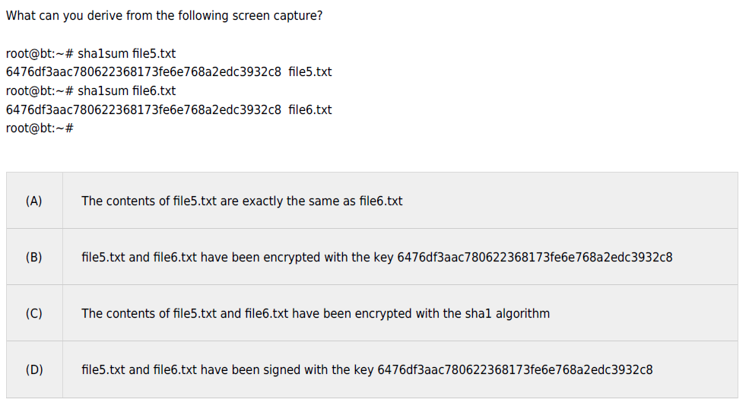
ANS: A

Slide 17
ANS: C
Which of the following can be used to manage and audit logons across a large network of embedded devices.
DNP3
Modbus
Radius
WSUS

Slide 18
ANS: A
In the context of critical infrastructure what does the acronym ISAC stand for?
a) Information Sharing and Analysis Center
b) Investigation Site and Automation Control
c) Indication, Sharing, Analysis and Compliance
d) Incident Stabilization and Containment

Slide 19
ANS: b
Which of the following is a characteristic of a “critical” -rated vulnerability?
a) It exists on an important server for the organization
b) It allows code execution from a remote, unauthenticated user
c) No patch exists yet for this particular vulnerability
d) It applies to all version of Windows

Slide 20
ANS: b
A company is needing reliable, low latency communications between a remote field site and headquarters located in a different country. They also require the ability to use their existing SSL VPN to protect information. Which protocol should they use?
a) 802.11n b) VSAT c)VLAN d)ISA100.11a

Slide 21
ANS: b
What must an attacker identify about a wireless network in order to perform a DoS attack against it?
a) a session key
b) the frequency
c) a previously used MAC address
d) the encryption algorithm

Slide 22
ANS: b
What is the main purpose of deploying Active Directory?
a) IP address management
b) User and computer management
c) OS Patch Management
d) Software application management

Slide 23
ANS: B
Which of the following locations would be the Unix equivalent of \Program files?
a) /boot
b) /usr
c) /root
d) /etc
e) /dev

Slide 24
File System Layout
Windows | Linux / UNIX
C:\ | / - root folder or root file system
\Windows | /boot - kernel /bin - core shell command for normal users /sbin - core shell commands for super users (root)
\Program Files \Program Files (x86) | /usr - higher level OS and third-party apps /var - writable storage for apps /tmp - temporary storage for apps
\Users \Documents and Settings | /root - root's home directory (*nix's administrator) /home - all normal user's home directories
Windows Registry | /etc - configuration directory
Windows APIs | /dev - interface with devices /proc - interface running processes /sys - interface with kernel
D:\ E:\ F:\ | All storage devices mounted somewhere inside / Most Linux distributions mount removable media in subfolders of /media
Notes:
There used to be a lot of variance in where different files were located in different UNIX "flavors," but modern UNIX variants have settled down to using the same general file system layout. The top of the file system tree is the "root directory," /. Below this directory are various important subdirectory trees.
The /dev directory contains the special "device files" that programs running on the system use to communicate with the physical hardware devices controlled by the operating system kernel. UNIX systems derived from the AT&T "System V" (SYSV) UNIX standard, such as Solaris and HP-UX, often will put these device files into the /devices directory but also usually maintain a /dev directory for compatibility with other systems.
/usr is where most of the critical components of the operating system live, including system binaries, programming libraries and tools, and online documentation. This directory structure can be thought of as being "read-only": After the operating system is loaded, not many changes under /usr should occur unless the operating system is upgraded or patches are installed. /var is where the system keeps frequently changing data, such as log files and temporary queues for system services like email and printing.
While programs provided with the operating system end up in directories like /usr/bin and /usr/sbin, other programs can be found scattered throughout the system. A standard convention is to put third-party software obtained from the internet into the /usr/local directory. SYSV derived machines systems like Solaris and HP-UX often will put third-party software (particularly commercial software) into /opt. Different sites may choose to use a different directory naming scheme for third-party software, however, such as /pkg or /sw.
User home directories often are found under /home. For large UNIX networks, though, /home often is an NFS mounted directory, and /export/home is the directory in which the files physically reside on the file server. Again, many other local conventions exist. Some sites prefer directory names like /users or /u1, /u2, …, and such.

Slide 25
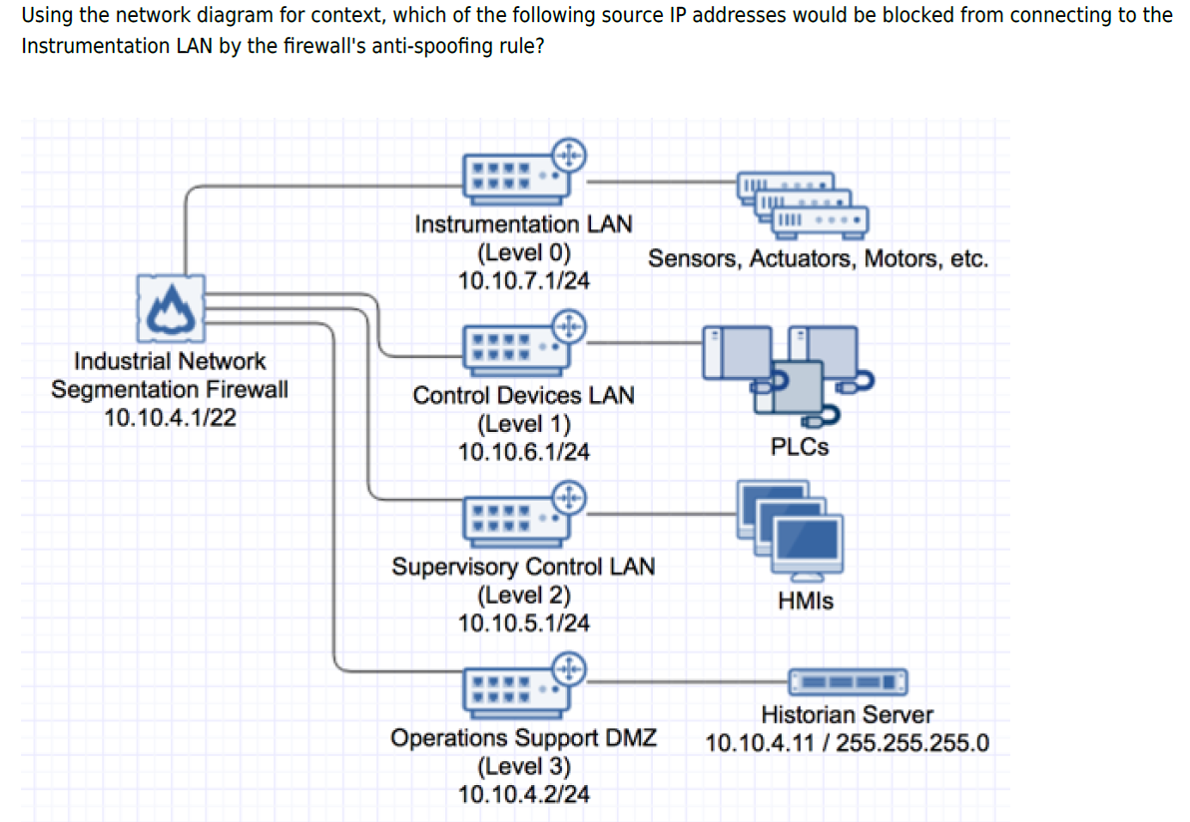
ANS: A
a) 10.10.7.1/24
b) 10.10.6.1/24
c) 10.10.5.1/24
d) 10.10.4.2/24

Slide 26
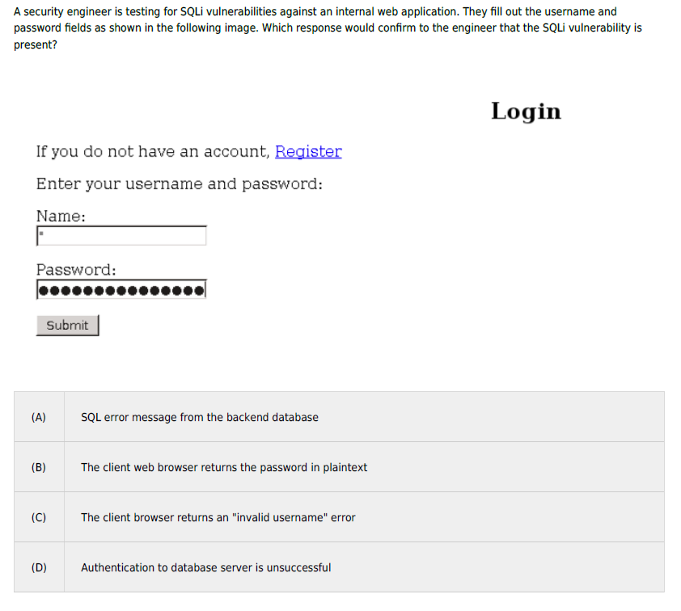
ANS: A

Slide 27
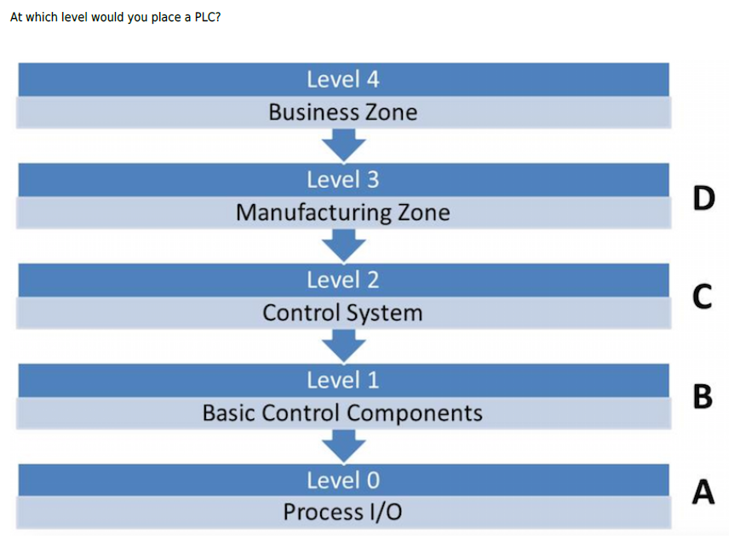
ANS: B

Slide 28
ANS: B
You have started working for a new ICS company and have been asked to determine the company’s attack surface for a team meeting next week. Which tool would help you with this task?
a) Oxygen
b) Shodan
c) Backtrack
d) Maltego

Slide 29
ANS: D
Corporate cyber security policies within an organization should be treated in which of the following ways for an ICS environment?
a) Only implemented in ICS test environments
b) Never implemented in ICS environments
c) Implemented as is
d) Customized for ICS environments

Slide 30
ANS: d
All ICS Systems need to have which of the following to strengthen operational availability?
a) a Business Continuity Plan
b) spare equipment at an offsite location
c) an operational backup facility
d) redundant components engineered into the system.

